Slide 1
Storytelling For Success: Leveraging PR for Maximum Marketing Impact
Presented by Risa B. Hoag | President | GMG Public Relations, Inc.

Slide 2
Overview
First - Thank you to HVDMA & Braden!
Goal Today:
Give you an understanding of how to use PR to increase your organization’s visibility.

Slide 3
Agenda
Understanding the PR Landscape
Why PR is a Powerful Marketing Tool
Crafting a PR Strategy
Pitching the Media
Success Stories

Slide 4
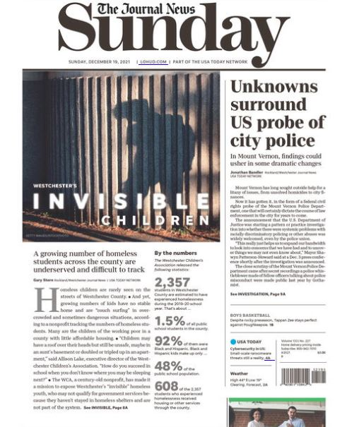
What is PR?
Lots of people confuse PR with advertising.
PR is “earned media.”
You do not pay the outlet for it. Except when you do! ☺

Slide 5
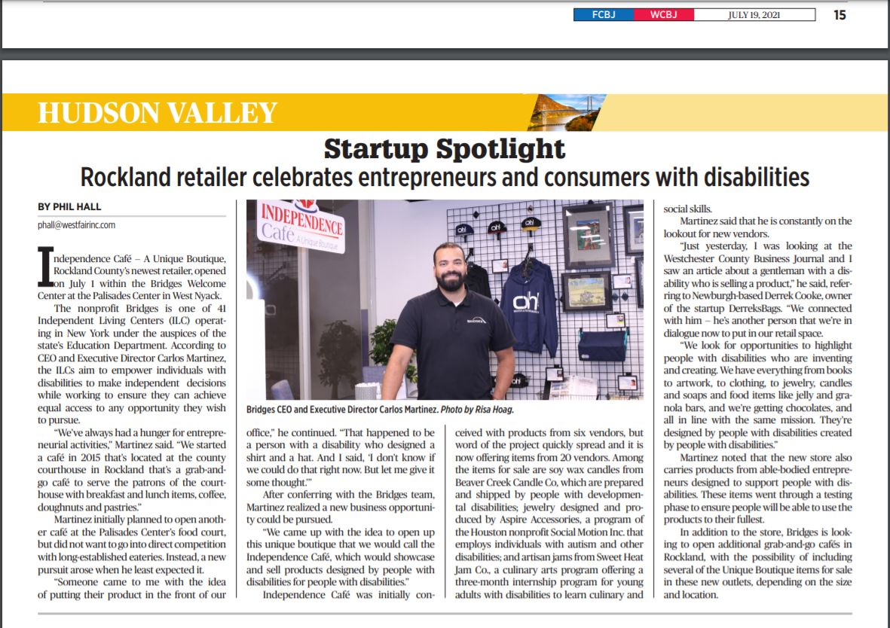
“Public relations is a strategic communication process that builds mutually beneficial relationships between organizations and their publics.”
About Public Relations - PRSA
“Public relations is the set of techniques and strategies related to managing how information about an individual or company is disseminated to the public, and especially the media.”
Investopedia

Slide 6
PR is storytelling.

Slide 7
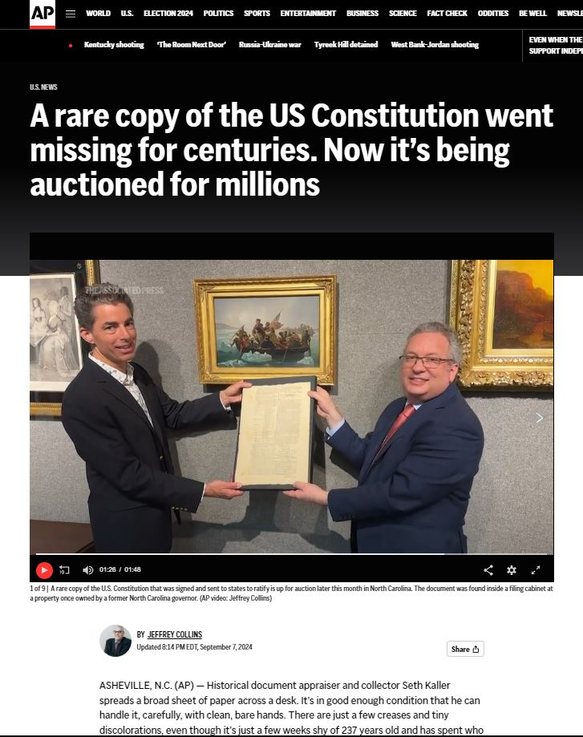
Crafting a story that is compelling enough to get a media rep (the gate keeper) to open an email and be intrigued and interested enough by the narrative inside to want to learn more.

Slide 8
It’s not: “I deserve a feature story.”
So, what makes a good story?
And how do I get the media to pay attention?

Slide 9
First, let’s understand the PR Landscape
It continues to evolve in many ways!

Slide 10
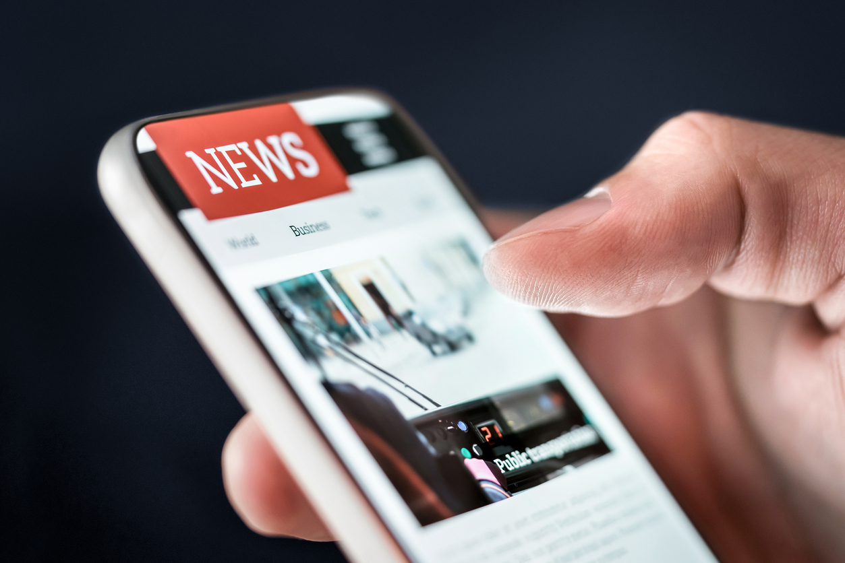
What’s Out There?
Print
Newspapers, local national
Magazines, local, national, trade
Television – local, national
Radio
Traditional, Satellite (Sirius)
Digital and online publications
Podcasts
Freelance writers
Blogs
News Agencies
Associated Press, Reuters
Social Media

Slide 11
How it has changed
Newspapers
Fewer Newspapers with fewer staff
However, local papers are still well read
More pay for play
Television
Local news still well watched
Radio
Fewer radio outlets like WCBS in NYC area
But they are still interested in good stories
Digital or online publications
Many options, needs research
Podcasts
Thousands, however, tough to access

Slide 12
Why is PR So Powerful
Builds and manages reputation
Builds brand identity and authority
Builds credibility and trust through earned media coverage
Viewed as more credible than an ad
Enhances visibility without extensive ad budgets
Establishes thought leadership
Can help contain crises
Influences public opinion
Supports the sales funnel
Facilitates partnerships and collaborations
Strengthens SEO

Slide 13
So where are the homes for your stories?
Start with your target market.
Describe it/them in great detail!
Identify the potential outlets.
Research the writers, producers, etc.

Slide 14
Strategy is important
What are the organization’s objectives? goals? Long term/short term.
What are the best ways to engage with your target market?
How does PR fit with the other marketing strategies?
How will success be measured?
What are the KPIs expected (key performance indicators)?
Are all stakeholders included in planning?
you would be surprised how often their goals don’t align

Slide 15
Strategy
Create a calendar, monthly, quarterly; include all marketing efforts so everything is tied together
Consistency is important!
You might go months without a story, then you might get a big hit. The key is consistency!
PR is both science and art!
While there are many opportunities for quick hits, the key is really playing the long game
Revisit your calendar often
Assess results and success
Consider new ideas; keep up with industry trends

Slide 16
Pitching
People think this is the hardest part.
It’s not.

Slide 17
Pitching Tips
Read the media you are targeting and listen carefully to broadcasts
Look at headlines in your news apps
What catches your eye?
What draws you in to read more?
Headlines/subject lines are critical!

Slide 18
Crafting a story that is compelling enough to get a media rep (the gate keeper) to open an email and be intrigued and interested enough by the narrative inside to want to learn more.
Components:
Compelling email subject line
Short but interesting narrative
Ties into what they already write about
Offers clear information as to the deadlines, parties effected, resources, and impact
Has a clear call to action on what to do next

Slide 19
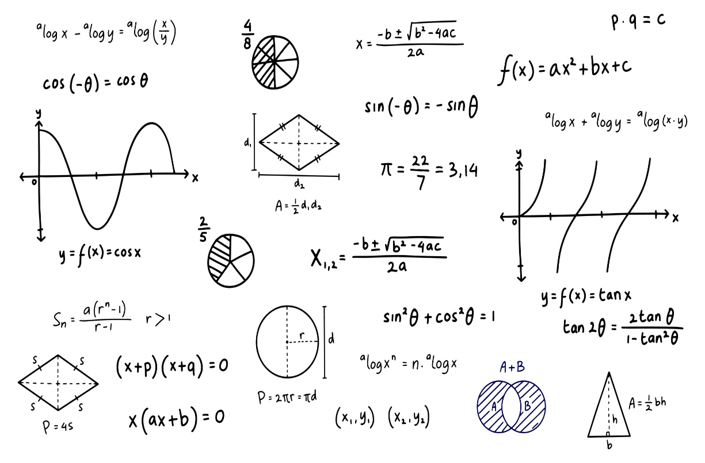
FORMULA FOR COMPELLING HEADLINES
INCLUDE NUMBERS WHERE POSSIBLE
ADD AN ADJECTIVE
USE A CALL TO ACTION WORD
USE POSITIVE WORDS | USE NEGATIVE WORDS
INCLUDE DETAILS
You can move the words around!
Number + Adjective + Noun + Keyword + Promise
How to + Action + Keyword + Promise

Slide 20
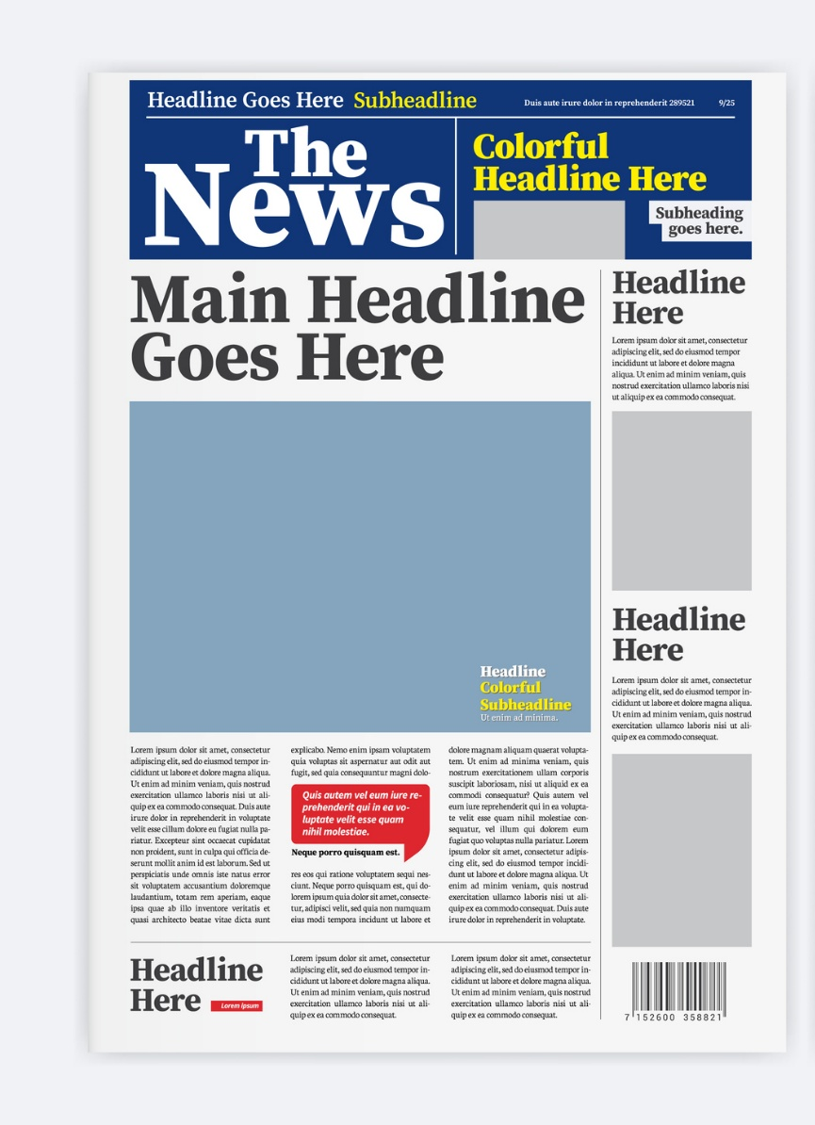
FORMULA
EXAMPLES:
5 Easy Ways to Write a Catchy Headline
How to Eat More Fiber Using 3 Simple Ingredients
Stop Making These 5 Mistakes in Your Kitchen
The 3 Best Ways to Pay for College this Fall
You get the idea!
Exercise!
Right now, develop a headline for your organization based on this formula that would be great for a press release.

Slide 21
Next – How to Reach the media?
Read the outlets you are going to pitch
Identify the contacts you want to target
What are they writing about?
Go to the outlets’ sites, find writer’s emails; Sometimes they are included in the bylines
Search online for emails for reporters, writers, producers
Use social media: LinkedIn, X, Bluesky

Slide 22
From an article in PR News November 2024
PRNEWS took an informal poll asking readers if they were sticking with X. The results are a combination of two polls conducted of 166 voters, one on PRNEWS' LinkedIn page and another on PRNEWS Managing Editor The question posed:
Is your brand moving away from X (Twitter)?
Answers (rounded to nearest percentage point):
Yes. Deactivated. Done. 37%
No, still using daily. 24%
Yes, and moved to Bluesky or Threads. 18%
Yes, but still using all the platforms (including X). 21%
The results showed a divide between communicators over who is and who isn’t using X. A total of 54.8% have left the platform and/or are using Bluesky or Threads. And 45% have not yet abandoned X and are utilizing many social media platforms in their toolbox.

Slide 23
When you pitch
Use a compelling subject line; go back to your headline writing and make it sound a little less click bait like
Include a hook! Work that into your first paragraph
Keep your pitch brief and to the point
Attach more details if needed; press release
Identify if there is an important date or deadline tied to the pitch
Reference any previous articles you have read of theirs which tie in to why you reached out to them

Slide 24
Take note…
Sometime you are just sending a press release announcement of a grand opening or promotion hoping to get coverage in local media.
Sometimes you just want to be listed in a calendar
But feature story pitching requires a hook!
Why should they care?
Why should their readers or audience care?
What is special or important or timely about it?
What is the bigger picture?

Slide 25
Hook Examples
A surprising or unexpected event, fact or outcome
Statistics that provide insight into a topic
Being ahead of a trend | Bucking a trend
The first of its kind | The last of its kind
Helpful tips pertaining to something everyone is familiar with
A new product or service that solves a problem
Something tied to the holidays, seasons or special days of the year

Slide 26
What happens next?
You follow up with an email 3-5 days later
You could follow up with a call
If they do not respond, do not badger
But if you have fresh information, you could follow up with those details
You may get a request for more information
If an interview is secured, do everything asked and provide as much info as requested in a timely manner
Accommodate whatever timeframe the reporter or producer asks for
Send a thank you email

Slide 27
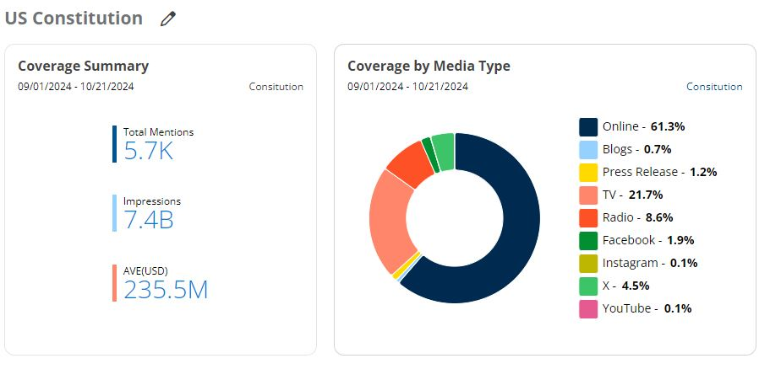
CASE STUDIES
US Constitution – AP
Astolat Dollhouse – NY TIMES

Slide 28
Thank you
Risa Hoag
President
GMG Public Relations, Inc.
www.gmgpr.com
risa@gmgpr.com
845-627-3000, Extension 1

