Slide 1
2024 Postal Insights: Roadmap to 2025 Marketing Success Using the New USPS Promotions Hudson Valley Direct Marketing Association April 23rd ,2024
Presenter:
Deborah Damore
Director, Postal Affairs & Operations
Enru Logistics and Postal Operations

Slide 2
AGENDA:
July 2024 Proposed Postage Rate Increase Marketing Mail
Second half of 2024 Postal Promotions
Mail Growth Incentive
2025 Promotions and Incentives
Appendix
First-Class, Periodicals, & Package Services in Appendix
Additional content on Mail Growth Incentive
Enru Logistics and Postal Optimization
Postal Preparedness And Strategy Session
This information is the sole property of the presenter and is not approved or endorsed by USPS. May not be shared without prior approval.
2

Slide 3
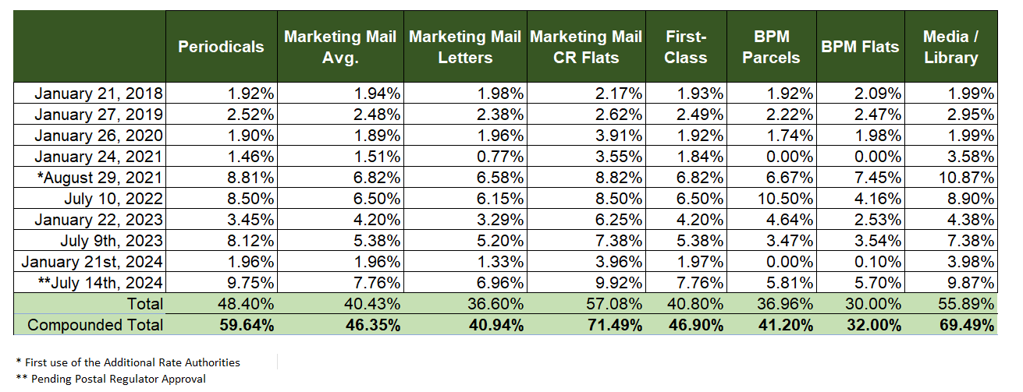
Timing & History
April 9th, 2024
USPS files R2024-2
for a summer postage increase
May 8th, 2024
Comments due to Postal Regulatory Commission (PRC)
May 30th, 2024
PRC will approve or remand the price filing
July 14th, 2024
New Market Dominant Rates become effective
Enru Logistics and Postal Optimization
This information is the sole property of the presenter and is not approved or endorsed by USPS. May not be shared without prior approval.

Slide 4
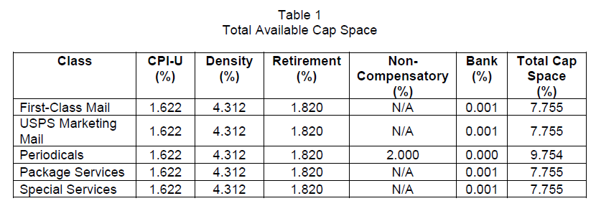
What’s included in the July 2024 Rate Adjustment?
****Can only be used ONCE annually
****May be used in EVERY increase
***
***
***
***
***
Within each class there are variables based on each mailing profile
Enru Logistics and Postal Optimization
Pending PRC Approval
This information is the sole property of the presenter and is not approved or endorsed by USPS. May not be shared without prior approval.

Slide 5
Marketing Mail
Enru Logistics and Postal Optimization
Price Change by Shape:
Letter-Shaped: 7.5%
Flat-Shaped: 9.0%
Product | % of Change
Letters | 6.958%
Flats (presort Mixed ADC – 5D) | 11.708%
Parcels | 7.790%
High Density/Saturation Letters | 7.327%
High Density/Saturation Flats & Parcels | 7.903%
Carrier Route | 9.918%
Overall | 7.55%
Variables within Products and Shapes:
Commercial Rates
High Density Letters 8.6%
High Density + Letters 3.2%
Saturation Letters 7.7%
Carrier Route Flats 9.01%
High Density Flats 8.2%
High Density + Flats 10.3%
Saturation & EDDM Flats 6.5%
Pending PRC Approval
This information is the sole property of the presenter and is not approved or endorsed by USPS. May not be shared without prior approval.

Slide 6
PROMOTIONS AND INCENTIVES AVAILABLE FOR THE REST OF 2024
Enru Logistics and Postal Optimization

Slide 7
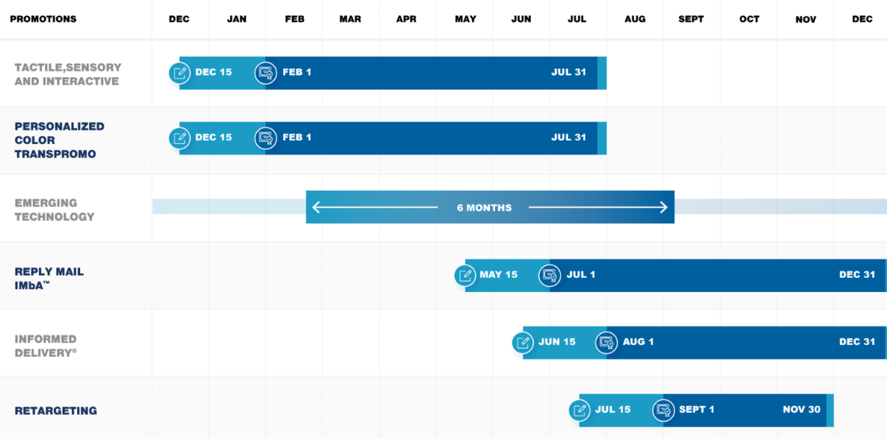
2024 USPS Promotions Calendar
5%
3-4%
3-4%
3-6%
4%
5%
Enru Logistics and Postal Optimization
This information is the sole property of the presenter and is not approved or endorsed by USPS. May not be shared without prior approval.

Slide 8
2024 USPS Mail Growth Incentive
REGISTRATION DATES
Mid-Nov. 2023 – June 2024
INCENTIVE PERIOD
Jan. 1, 2024 – Dec. 31, 2024
WHO IS ELIGIBLE
Mail Owner
INCENTIVE DETAILS
CREDIT DETAILS
Pieces mailed in calendar year 2024 more than FY23 (Oct 1, 2022 – Sep 30, 2023), with a minimum of 1,000,000 pieces.
Mail volume Jan 1 – June 30th, 2024, if more than FY23, credit issued, if not then next looking at Jan 1 – Sept 30, if more than FY23 credit issued, if not looking at Jan 1 – Dec 31, if more than FY23 credit issued. IF credit earned by July payout, then all mailings from July-Dec will earn credits as well.
Incentive Measurement
Credit Calculation
a 30% postage credit for the incremental volume in CY 2024 (vs. baseline FY 2023 volume) times the average actual price paid per mail piece for qualifying mail during the incentive period.
Incentive Amount
Credit Distribution Dates
July 2024
October 2024
Jan/Feb 2025
INCLUDES
Marketing Mail letters & flats
CR products and MM Parcels
First-Class letters, cards & flats
NOT INCLUDED
EDDM retail
Single piece First-Class
First-Class Parcels
Credit Use
May only be used on the same class of mail the credit was earned
Incentive Payout
NOT a discount on postage statement, paid as credits for future postage use.
Credit Expiration
Credits may be used immediately after receipt and must be used by end of calendar year 2025.
Call Enru for help with discounts
MARKETING MAIL AND FIRST CLASS ELIGIBLE
Will be back for 2025!
Enru Logistics and Postal Optimization
Pending PRC Approval
This information is the sole property of the presenter and is not approved or endorsed by USPS. May not be shared without prior approval.

Slide 9
EMERGING AND ADVANCED TECHNOLOGY
Use the latest digital technologies in mailpiece to create exciting customer experiences
Eight ways to participate, red receives 4% discount:
Enhanced Augmented Reality
Basic Integration with Voice assistant
Mobile Shopping (now incorporated)
Advanced Integration with Voice assistant
Video in Print Technology
Near Field Communication
Mixed Reality
Virtual Reality
Registration: NEW Process
Promotion Runs: Mailers choose their own six-month period – start date begins on first mail date claiming the discount and runs then for six consecutive months.
Includes: First-Class letters & flats
& Marketing Mail letters & flats
Discount level: 3% to 4%
Enru Logistics and Postal Optimization

Slide 10
INTERACTIVE DESIGN
• Enable virtual customer experiences, this was designed for Lovesac for consumers to visit a virtual showroom by scanning a QR code
Utilizes 360° software and photography
Lovesac showroom details:
Products shoppable within virtual environment
Learn more about features and benefits
Enru Logistics and Postal Optimization

Slide 11
TACTILE, SENSORY, & INTERACTIVE (TSI)
Designed to encourage marketers to use innovative techniques and treatments on their mailpieces to drive response.
The three featured categories in the promotion are:
Specialty inks (sheens, reactive colors, special effects)
Sensory Treatments (texture, scent, visual)
Interactive elements (pop-ups, infinite folds, dimensional treatments)
Newer techniques incorporated:
Zip strips
Clean release cards
Holographic stickers
Paper that incorporates sound chips or speakers
Paper that incorporates edible components
The mailpiece can incorporate one or more of the treatments on the outside of the envelope, on the actual mailpiece, or both.
INELIGIBLE
Treatments that do not:
Appear to be both visible and distinguishable
Enhance the engagement and value of the marketing message and mailpiece
Blow in cards, inserts, order forms or reply envelopes
Registration: December 15th, 2024
Promotion Runs: Feb 1st – July 31st
Includes: Marketing Mail Commercial, Nonprofit letters & flats and First-Class letters, cards & flats
Discount level: Remains at 5%
NOTE – GLOSS STOCK will not be eligible in 2025
Enru Logistics and Postal Optimization
This information is the sole property of the presenter and is not approved or endorsed by USPS. May not be shared without prior approval.

Slide 12
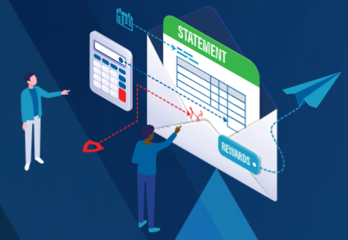
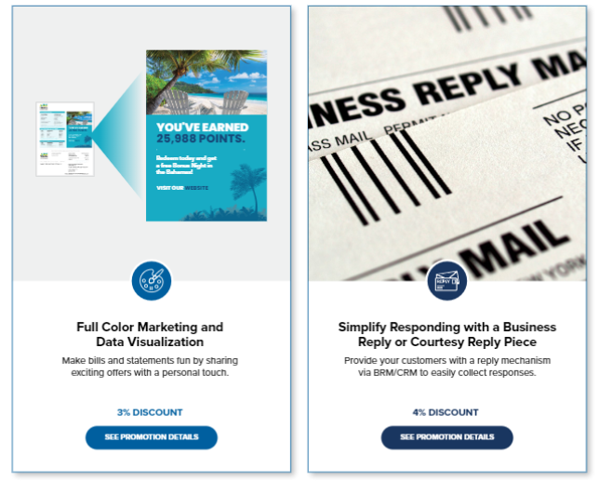
PERSONALIZED COLOR TRANSPROMO
Designed to highlight marketing messages using color incorporated in bills and statements.
Must include a full (2 or more) color marketing message or visualization of account data in colors not including black, white, or grayscale.
The message must be printed on the bill itself; an insert will not qualify.
Marketing message must be based on specific customer based on behavior or demographics
Registration: December 15th
Promotion runs: Feb 1st – July 31st
Eligible Mail Options: First-Class presort and automation letters
Mailpiece Content Restrictions: Bill, Statement, Account Summary or Notices.
Discount: 3%
If including a reply mechanism 4%
Enru Logistics and Postal Optimization
This information is the sole property of the presenter and is not approved or endorsed by USPS. May not be shared without prior approval.

Slide 13
REPLY MAIL IMbA
By adopting Intelligent mail barcode Accounting (IMbA), Qualified Business Reply Mail (QBRM) and High Volume QBRM, customers can improve visibility, while also delivering easier payment methods and faster delivery speeds.
For information about onboarding IMbA - https://postalpro.usps.com/imba-fact-sheet
Registration: May 15th, 2024
Promotion Runs: July 1st - Dec 31st
Eligible Reply Mail Options: First-Class Single-piece Qualified Business Reply Mail & High-volume Qualified Business Reply Mail letters and cards.
Discount level: 3% for static barcode &
6% serialized barcode.
Discount is off of the monthly statements for the Reply Mail that is received during the promotion period.
Enru Logistics and Postal Optimization
This information is the sole property of the presenter and is not approved or endorsed by USPS. May not be shared without prior approval.

Slide 14
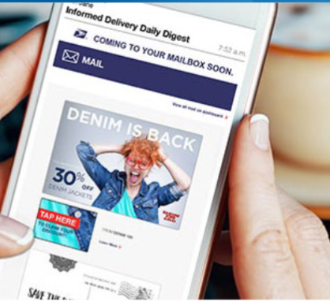
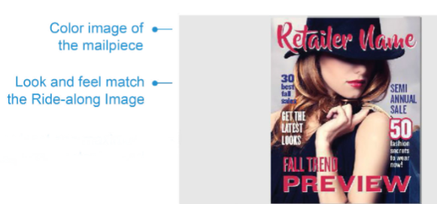
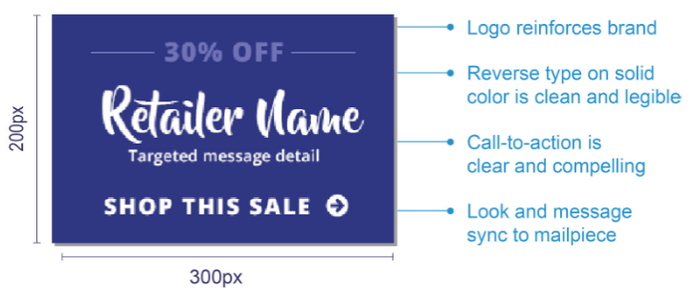
Enru Logistics and Postal Optimization
INFORMED DELIVERY
Encourages mailers to incorporate informed delivery into direct mail to create positive consumer experience
Required for all submissions:
Ride-along color image
Call-to-action
Live working URL
Steps to promotion:
(Enru managed as a service offering)
Register for Informed Delivery
Pre-Approval using the Mailing Promotions Portal (MPP)
Create campaign in Mailer Campaign Portal (MCP)
Load target URL, Representative Image, and Ride Along Image
File updates of serial number range, MID, campaign start/end date, ID code
Required for all flat mail:
Representative image (in color)
PDF of the front & back of the physical mail piece
Registration: June 15th, 2024
Promotion Runs: Aug 1st – Dec 31st
Includes: Automation Marketing Mail Commercial, Nonprofit letters & flats and First-Class Automation letters, cards & flats including USPS Marketing Mail Commercial and Nonprofit DDU entered Carrier Route Saturation Flats
Discount level: Remains at 4% & 0.5% incentive for eDoc submitter
This information is the sole property of the presenter and is not approved or endorsed by USPS. May not be shared without prior approval.

Slide 15
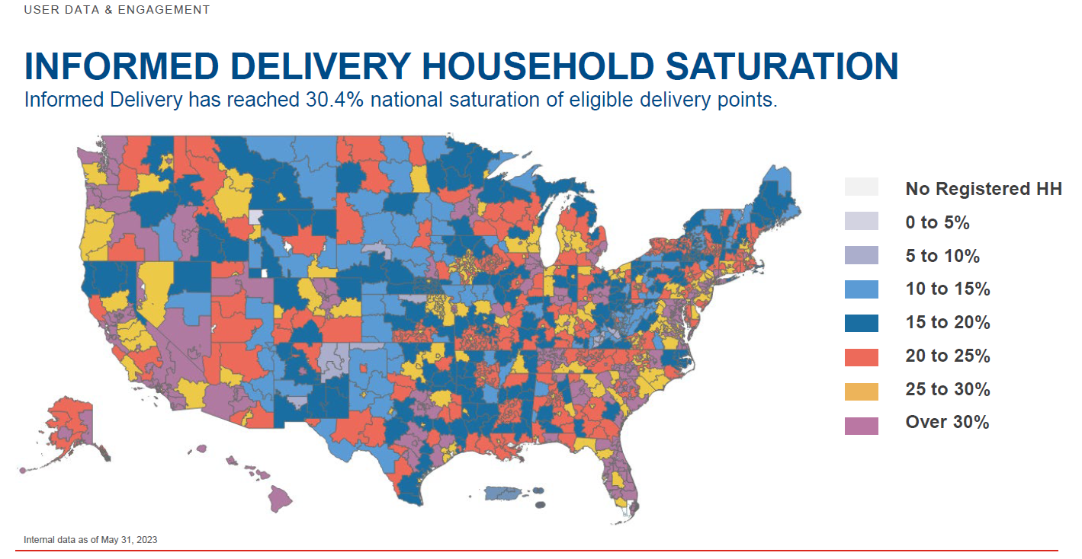
Enru Logistics and Postal Optimization
This information is the sole property of the presenter and is not approved or endorsed by USPS. May not be shared without prior approval.

Slide 16
Enru Logistics and Postal Optimization
RETARGETING
Provides 5% discount on for First-Class Mail automation postcards that are mailed in connection with website or app behavior during program period.
Registration: July 15th, 2024
Promotion Runs: Sep 1st – Nov 30th
Includes: First-Class Postcards
Discount level: 5%
This information is the sole property of the presenter and is not approved or endorsed by USPS. May not be shared without prior approval.

Slide 17
New Catalog Incentive
Discount: $1 p/1000 pieces
Marketing Mail & Bound Printed Matter Flats
Shapes: Letters, Flats, and Parcels
Registration: None, self identification in postage statement.
Incentive Period: Effective July 14th, 2024
Catalog Definition:
12 or more pages long (6 sheets of paper)
Bound or fastened along one edge (e.g., stapled, glued, sewed, etc.); and
Any shape (letter, flat, or parcel).
Includes Prices or a method to determine prices;
A qualifying catalog must also provide —
An organized, illustrated, descriptive listing of the products or services offered for sale
Fulfillment information and options (e.g., available shipping methods or pickup options); and
Enough information to allow an order to be placed (e.g., an order form, mailing address, telephone number, web address, or means to access a web address such as a QR code).
New definition to be updated in DMM through efforts from the American Catalog Mailers Association and their Postal Committee
Pending PRC Approval
Enru Logistics and Postal Optimization
This information is the sole property of the presenter and is not approved or endorsed by USPS. May not be shared without prior approval.

Slide 18
2025 USPS Promotions
There is a conflict of information on the promotion period for Continuous Contact.
The original calendar April 30 – Sept 30
The price filing to PRC July 1st – December 31st
Pending PRC Approval
Enru Logistics and Postal Optimization
This information is the sole property of the presenter and is not approved or endorsed by USPS. May not be shared without prior approval.

Slide 19
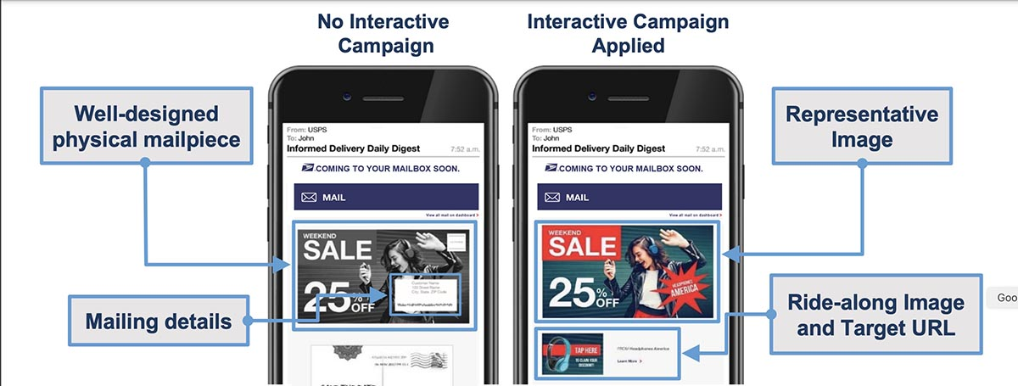
Promotion Add Ons– New Concept for 2025
Add-Ons may be used on First-Class or Marketing Mail if they are participating in another promotion at the same time.
Add-Ons can be stacked using both as well as the Catalog Incentive within a single mailing.
Sustainability – 1%
Discount for sustainable mailing materials
Marketing Mail and First-Class Letters & Flats
Will require evidence and printing of certification
Informed Delivery – 1%
This is no longer a stand-alone promotion
Marketing Mail and First-Class Letters & Flats
Will continue to provide an eDoc submitter incentive.
Enru Logistics and Postal Optimization
Pending PRC Approval
This information is the sole property of the presenter and is not approved or endorsed by USPS. May not be shared without prior approval.

Slide 20
POSTAL OPTIMIZATION
LOOKING AHEAD 2025 PROMOTIONS
USPS Promotions & Incentives
Discount: 3%
Eligibility: First-Class letters, cards, flats & Marketing Mail letters & flats .
Promo Period: Anytime in 2025 for 6 consecutive months. Replaces Emerging & Advanced Tech, mobile shopping will retire or be modified
NEW Integrated Technology
Tactile, Sensory & Interactive
Discount: 4%
Eligibility: First-Class letters, cards, flats & Marketing Mail letters, flats.
Promo Period: Feb 1 - July 31
Designed to encourage innovative techniques & treatments to drive response.
Precoated stock paper will not qualify alone for the promotion in 2025.
Become the expert so you can navigate this years' postal changes, and effectively optimize your direct mail and print programs.
NEW Continuous Contact
Discount: 3%
Eligibility: Marketing Mail letters & flats.
Promo Period: Under Consideration
For Marketing Mail that is delivered to the same person multiple times to follow-up the original mailing. Content of each mailing needs to be iterative or complementary, not duplicative
Direct Mail Solutions
Discontinued Qualifications in 2025
Reply Mail
IMbA
Discount: 3% - 6%
Eligibility: QRBM, High Volume QRBM
Promo Period: May 15th – Dec 31st
Gloss cover stock will no longer apply for a promotion discount.
Mobile shopping is under review for possible retirement or modification.
NEW
First-Class Advertising
Discount: 3%
Eligibility: First-Class letters, cards, flats
Promo Period: Sept 1 – Dec 31
Include a two-color Marketing message in your First- Class Mail piece
Enru Logistics and Postal Optimization
Pending PRC Approval
This information is the sole property of the presenter and is not approved or endorsed by USPS. May not be shared without prior approval.

Slide 21
Resources
R2024-2 USPS filing for rate increase - https://prc.arkcase.com/portal/docket-search/advanced/filing-details/128429
USPS price change webinar - https://postalpro.usps.com/node/12939
USPS Mail Growth Incentive - https://postalpro.usps.com/msi
USPS 2024 Promotions - https://postalpro.usps.com/promotions
July 2024 Postage Statements & excel price files - https://pe.usps.com/PriceChange/Index#JulyPriceChangeSection
USPS “The Eagle magazine” published quarterly with updates.
The Eagle Magazine - Resources - About.usps.com
Enru Logistics and Postal Optimization
This information is the sole property of the presenter and is not approved or endorsed by USPS. May not be shared without prior approval.

Slide 22
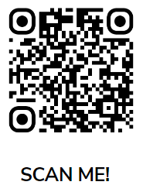
QUESTIONS??
Deborah Damore
Director, Postal Affairs
Enru Logistics and Postal Optimization
Deborah.Damore@enru.io
630-809-4196

Slide 23
Incentives and Permit Fees
 | Current | Proposed | % of Change
First-Class & Marketing Mail Full-Service incentive | $0.003 | $0.005 | +66.7%
Periodical & Package Services Full-Service incentive | $0.001 | $0.001 | 0%
First-Class & Marketing Mail Seamless incentive | $0.001 | $0.002 | +100%
Periodical & Package Services Seamless incentive | $0.001 | $0.001 | 0%
Permit Application Fee | $320 | $350 | +9.4%
Periodical Application Fee | $950 | $1,040 | +9.5%
Enru Logistics and Postal Optimization
Pending PRC Approval
This information is the sole property of the presenter and is not approved or endorsed by USPS. May not be shared without prior approval.

Slide 24
Periodical Mail
Inside County | Price Change %
Total Price Change | 9.7%
Pounds | 0.0%
Pieces | 12.8%
Outside County | Price Change %
Total Price Change | 9.8%
Pounds | 0.0%
Pieces | 13.8%
Bundles | 0.0%
Sacks | 0.0%
Trays | 0.0%
Pallets | 0.0%
Ride Along rate remains at $0.191
Piece Rate for Machinable Flat Barcoded
Bundle Level | Current $ | New Price $ | Price Change %
CR Saturation | $.194 | $.205 | 5.67%
CR High Density | $.230 | $.248 | 7.83%
CR Basic | $.264 | $.289 | 9.47%
5-Digit | $.465 | $.526 | 13.12%
3-Digit | $.596 | $.657 | 10.23%
ADC | $.636 | $.706 | 11.01%
Mixed ADC | $.700 | $.770 | 10.00%
Spread Increases per 1000 pieces
5-Digit to CR Basic $36
CR Basic to HD $7
$.034
$.041
$.201
$.237
Enru Logistics and Postal Optimization
Pending PRC Approval
This information is the sole property of the presenter and is not approved or endorsed by USPS. May not be shared without prior approval.

Slide 25
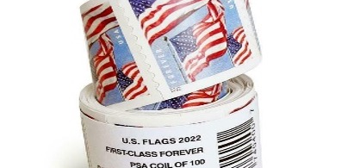
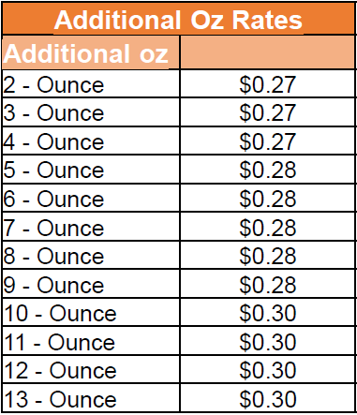
First-Class
Product | Current Price | Price Change | Change %
Rate Authority |  |  | 5.4%
Stamp Price | 68¢ | 73¢ | 7.4%
Meter Price | 64¢ | 69¢ | 7.8%
Single-Piece Cards | 53¢ | 56¢ | 5.7%
Single-Piece Flats– 1 ounce | $1.39 | $1.50 | 7.9%
Additional ounce rate Letters & Flats | 24¢ | 28¢ | 16.7%
Nonmachinable surcharge – letters | 44¢ | 46¢ | 4.5%
Presorted Letters (Auto & Nonauto) | 51¢* | 55¢* | 7.6%
Presorted Cards (Auto & Nonauto) | 36¢* | 39¢* | 7.4%
Presorted Flats (Auto & Nonauto) | $1.53* | $1.68* | 9.2%
First-Class Mail International Outbound | $1.55** | $1.65** | 6.5%
Widened incentive to presort.
$8 more per 1000 to sort to 5-D from AADC letters
Changed Flat Additional Ounce structure from static rate per ounce to allow for more flexibility.
Enru Logistics and Postal Optimization
* Average revenue per piece **First-Class Mail International letters & cards 1oz prices
Pending PRC Approval
This information is the sole property of the presenter and is not approved or endorsed by USPS. May not be shared without prior approval.

Slide 26
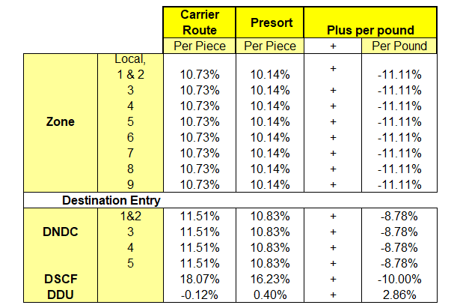
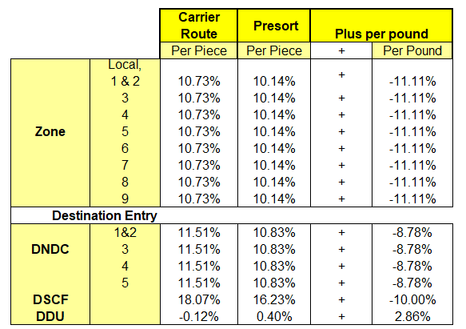
Package Services
Product | % Change
Alaska Bypass Service | 4.771%
Bound Printed Matter Flats | 5.696%
Bound Printed Matter Parcels | 5.806%
Media and Library Mail | 9.867%
Overall | 7.755%
0% change to BPM Flat and BPM Parcel Nonpresorted rates.
Media / Library Mail are non-compensatory
Bound Printed Matter Parcels
Bound Printed Matter Flats
Pending PRC Approval
Enru Logistics and Postal Optimization
This information is the sole property of the presenter and is not approved or endorsed by USPS. May not be shared without prior approval.

Slide 27
Changes in MM Flat Spreads
Enru Logistics and Postal Optimization
Rates shown include Pallet Incentives as 5D mail on SCF pallet and CR and above on Direct Sort Pallets
Spread increases:
Per/1000 pieces
Commercial
5D SCF to CR SCF +$30
CR SCF to HD SCF +$6
HD SCF to HD+ SCF +3
Marketing Mail Auto Flats <4oz. | Current Price | New Price | $ Difference | % Difference
HD+ DSCF | $0.225 | $0.250 | $0.025 | 11.1%
HD DSCF | $0. 294 | $0.322 | $0.028 | 9.5%
CR Basic DSCF | $0.367 | $0.401 | $0.034 | 9.3%
5-Digit DSCF | $0.527 | $0.591 | $0.064 | 12.1%
NP HD+ DSCF | $0.131 | $0.139 | $0.008 | 6.1%
NP HD DSCF | $0.193 | $0.239 | $0.046 | 23.8%
NP CR Basic DSCF | $0.266 | $0.318 | $0.052 | 19.5%
NP 5-Digit DSCF | $0.288 | $0.355 | $0.067 | 23.3%
$.069
$.072
$.073
$.079
$.160
$.190
$.062
$.100
$.073
$.079
$.022
$.037
Pending PRC Approval
This information is the sole property of the presenter and is not approved or endorsed by USPS. May not be shared without prior approval.

Slide 28
Next Three-Year Forecasts as provided by USPS

Slide 29
2024 USPS MAIL GROWTH INCENTIVE
Marketing Mail and First Class eligible
Registration: November 2023 – June 2024
Incentive Period: January 1st, 2024 – December 31st, 2024
Includes: Marketing Mail letters & flats, CR products and MM Parcels, First-Class automation letters, cards & flats
Not Included: EDDM retail, Single piece First-Class or First-Class Parcels
Who is eligible: Mail Owner CRID
Incentive measurement: Pieces mailed in calendar year 2024 in excess of FY23 (Oct – Sep) at a minimum of 1,000,000
Incentive amount: a 30% postage credit based on the incremental volume in CY 2024 (vs. baseline FY 2023 volume) times the average actual price paid per mail piece for qualifying mail during the incentive period.
Incentive payout: NOT a discount on postage statement, paid as credits for future postage use.
Credit calculation: Mail volume Jan 1 – June 30th, 2024, if in excess of FY23, credit issued, if not then next looking at Jan 1 – Sept 30, if in excess of FY23 credit issued, if not looking at Jan 1 – Dec 31, if in excess of FY23 credit issued. IF credit earned by July payout, then all mailings from July-Dec will earn credits as well
Credit distribution dates: July 2024, October 2024, Jan/Feb 2025
Credit use: May only be used on the same class of mail the credit was earned
Credit expiration: Credits may be used immediately after receipt and must be used by end of calendar year 2025.
USPS expectation: The Postal Service is estimating this incentive will result in additional 17% of Marketing Mail
Approved by the Postal Regulatory Commission.

Slide 30
CREDIT CALCULATION
Pending Postal Regulatory Commission approval.
The credits earned are equal to the average actual per-piece price paid for all qualifying volumes, after other incentives and promotions, i.e., the total actual price paid for all qualifying pieces divided by the total volume of qualifying pieces.
For example, assume a mailer sends 5 million qualifying pieces in calendar year 2024 and sent 4.5 million qualifying pieces in fiscal year 2023.
Using below as an example of marketing mail, let’s say product 1 is letters, product 2 is flats, and product 3 is Marketing Mail parcels. Total 5mm pieces at an average postage rate of $.639 after all promotions and incentives had been removed.
Mailer mailed 4.5 mm in 2023, so they would receive credit for 30% of the average postage on 500,000 pieces.
500,000 * 0.639*0.30 = $95,850
Credits will be issued in July, October of 2024 and in January or February of 2025.
Credits can be used immediately once received but must be used by end of CY 25

