Slide 1
2024
NEW! EMAIL MARKETING TIPS & TRENDS THAT WORK
PRESENTED BY:
SPEAKER: Jay Schwedelson
Founder: SubjectLine.com
Founder: GURU Media Hub [GuruMediaHub.com]
CEO: Outcome Media [OutcomeMedia.com]

Slide 2
WHERE DO MY TRENDS COME FROM?

Slide 3
TITLE > CONTENT

Slide 4
YOU CAN ONLY PICK ONE:
GUIDE
EBOOK
REPORT
WHITEPAPER

Slide 5
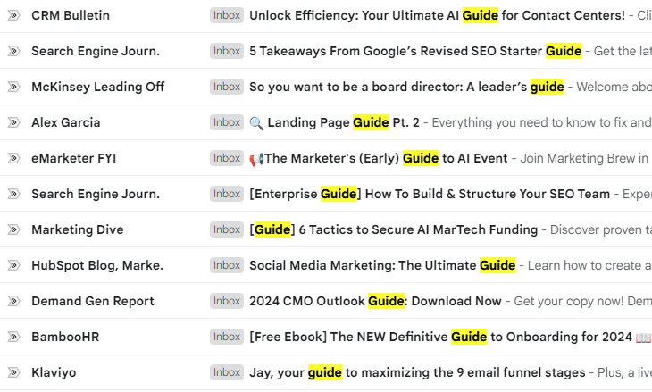
EBOOK VS. GUIDE
GUIDE = 30% HIGHER DOWNLOAD RATE

Slide 6
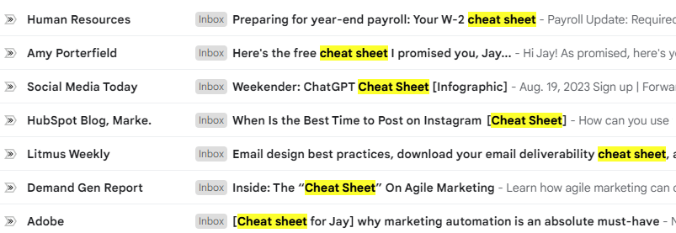
CHECKLIST VS. CHEAT SHEET
CHEAT SHEET = 40% HIGHER DOWNLOAD RATE

Slide 7
STUFF YOU ARE NOT TESTING…YET

Slide 8
CREATE WEBINAR URGENCY…
First 100 to Register Get PITFALL TO AVOID Tip Sheet!
ONLY First 100 to Register Get ON-DEMAND Access!
‘SPEED TO REGISTER’ INCREASING REGISTRATION RATES BY 40%

Slide 9
BONUS CONTENT
ONLY For Attendees: 7 New AI Prompts for Marketers
EXCLUSIVE CONTENT TIED TO ‘SHOW-UP’ INCREASES LIVE ATTENDANCE BY 25+%

Slide 10
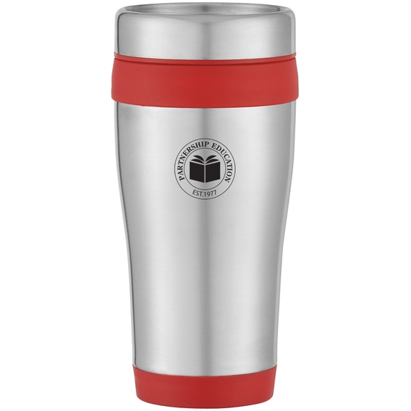
YAY. A CUP.

Slide 11
GIVE AWAY EXPERIENCES
Your Zoom with VP of Engineering…
See it BEFORE EVERYONE Else….
‘Experience’ Giveaways Lead to Conversion 8x vs. Swag (BUT LOWER SUBMISSION RATE…So less wasted time!)
SOURCE: Worldata Research Response Rate Campaign Aggregate 2023

Slide 12
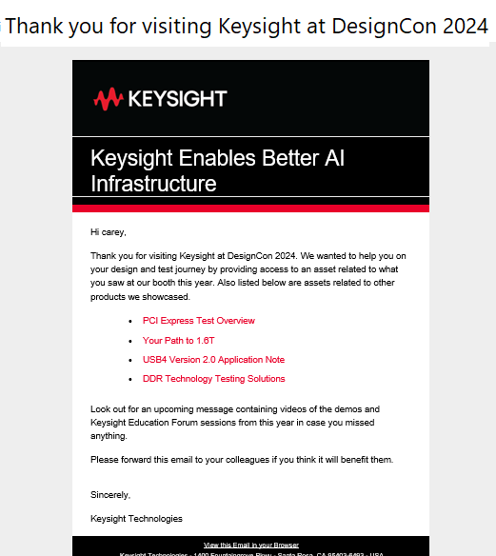
THIS IS THE
MOST IMPORTANT EMAIL
YOU WILL EVER SEND THIS PERSON…
IT IS NOT A ‘RECEIPT’

Slide 13
THIS IS THE
MOST IMPORTANT EMAIL
YOU WILL EVER SEND THIS PERON…
IT IS NOT A ‘RECEIPT’
GETTING FIRST EMAIL SENT TO NEW CONTACT OPENED WILL INCREASE THE LIKELIHOOD OF STAYING IN THAT PERSON'S INBOX BY OVER 80%

Slide 14
THIS IS THE
MOST IMPORTANT EMAIL
YOU WILL EVER SEND THIS PERON…
IT IS NOT A ‘RECEIPT’
Thank You! And…
EXCLUSIVE: DesignCon Attendees ONLY…
DesignCon: Just for Attendees…
Thank You! Special Guide Inside…

Slide 15
NAME PERSONALIZATION:
“For the first time in the history of our Email Benchmarks report, we’re seeing that personalized emails USING FIRST NAME IN SUBJECT LINE perform WORSE than generic ones. And this applies to opens, clicks, and even unsubscribes.
Source: GetResponse Email Benchmark Report

Slide 16
SUBJECT LINE:
Ford Motor needs to avoid this…

Slide 17
SUBJECT LINE:
Only for TOP Manufacturing Pros…

Slide 18
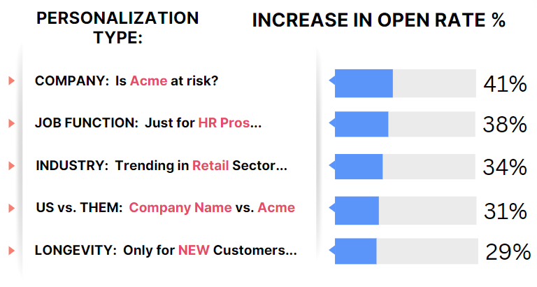

Slide 19
MYTH:
WE ARE SENDING TOO MUCH…

Slide 20
NOPE…
YOU NEED TO SEND A LOT.
BUT YOU HAVE AN AGENDA…

Slide 21
Become a valuable resource, a thought leader…USEFUL!
SOURCE: Worldata Research Response Rate Campaign Aggregate 2023

Slide 22
BUSINESS:
TOP PERFORMING SCHEDULE:
3 SENDS OVER 10 DAYS:
GIVE, GIVE, ASK =
55% HIGHER CLICK-THROUGH RATE ON ‘ASK’ SEND

Slide 23
CONSUMER:
TOP PERFORMING SCHEDULE:
3 SENDS OVER 7 DAYS:
ASK, GIVE, ASK =
40% HIGHER CLICK-THROUGH RATE ON ‘ASK’ SEND

Slide 24
1ST PERSON
CALL-TO-ACTION BUTTONS WRITTEN IN 1ST PERSON INCREASE CLICK-THROUGH RATE BY 28%

Slide 25
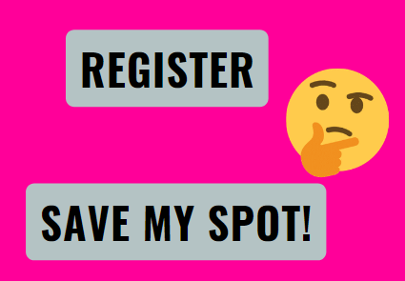
1ST PERSON
START MY FREE TRIAL NOW!
GET MY EXCLUSIVE DISCOUNT!
CLAIM MY SPOT TODAY!
DOWNLOAD MY EBOOK INSTANTLY!
UNLOCK MY SAVINGS!
SEND ME THE SAMPLE!
RESERVE MY SEAT!
SHOW ME THE DEALS!
GIVE ME ACCESS!
I WANT IN!
SEND ME THE GUIDE NOW!
START MY JOURNEY!
COUNT ME IN!
SEND ME THE COUPON!
GIVE ME THE INSIGHTS!
GIVE ME THE DISCOUNT CODE!
SHOW ME THE EXCLUSIVE CONTENT!
LET ME START SAVING!

Slide 26
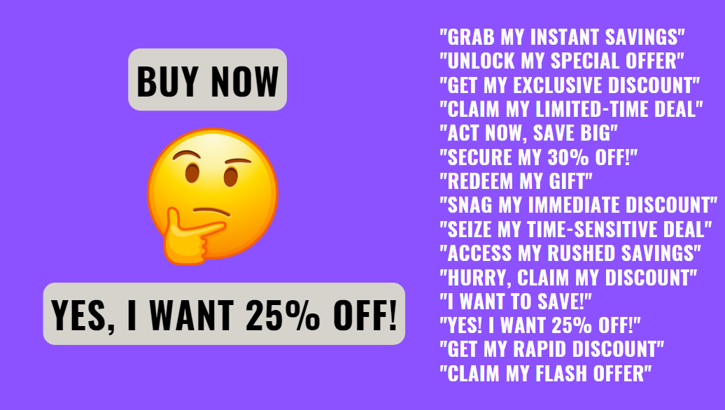

Slide 27
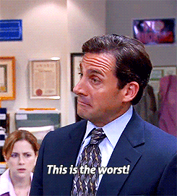
Jay’s Session Rating!
Source: GIPHY

Slide 28
"Transformed my business overnight! 🚀 - CEO's testimonial"
"Saved us time and money! 💰 - Happy Customer"
"Revolutionized our workflow! ⚡ - Satisfied Client"
"The secret to our success! 🔑 - Raving Review"
"Doubled our ROI in weeks! 💼 - Client Testimonial"
"Unmatched quality and service! 👌 - Impressed Customer"
"Exceeded all expectations! 🌟 - Thrilled Client"
"Game-changer for our industry! 🎮 - Happy User"
"Best investment we ever made! 💡 - Client Feedback"
"Achieved results beyond belief! 🎉 - Delighted Customer"
SUBJECT LINES:
TESTIMONIAL SUBJECT LINES IN OUTREACH EMAILS:
INCREASE OPEN RATES 22%

Slide 29
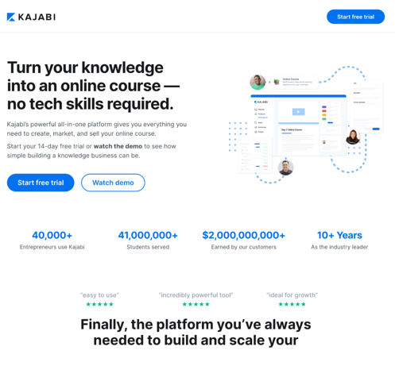
Destination Pages That Have Client Testimonials Have Increased Conversion Rates:
Consumer = UP 22%
Business = UP 27%

Slide 30
PAUSE FOR SUPER EASY TIP:
INSTANTLY FIND THE BEST CONTACTS…

Slide 31
PAUSE FOR SUPER EASY TIP:
SEND EMAIL THE DAY BEFORE BIG HOLIDAY!!
WHAT???

Slide 32
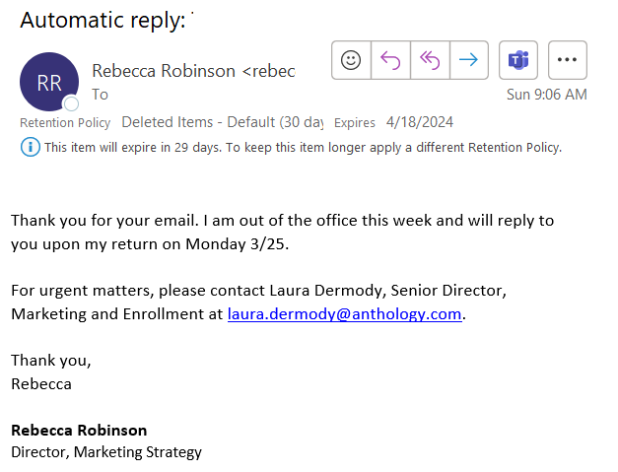

Slide 33
STUFF YOU ARE NOT TESTING…YET

Slide 34
LOVE IS BLIND
IS THE SECRET TO EMAIL PERFORMANCE

Slide 35
THE WAY EMAIL ‘DATING’ WORKS...

Slide 36
THE WAY EMAIL ‘DATING’ WORKS...

Slide 37
‘REPLY WITH’ = INCREASES RESPONSE RATE OF 400%+
EXTRA BONUS:
INCREASES INBOXING RATE BY 75%+

Slide 38
‘REPLY WITH’ = “GUIDE”
“DISCOUNT CODE”
“LINK TO VIDEO”
“INVITE”
“YES”
REPLY!

Slide 39
ONE MORE THING BEFORE THE FREE STUFF…
IF WE ARE NOT CONNECTED ON LINKEDIN PLEASE SEND ME A CONNECTION REQUEST!
I AM ON INSTAGRAM: @JAYSCHWEDELSON

Slide 40
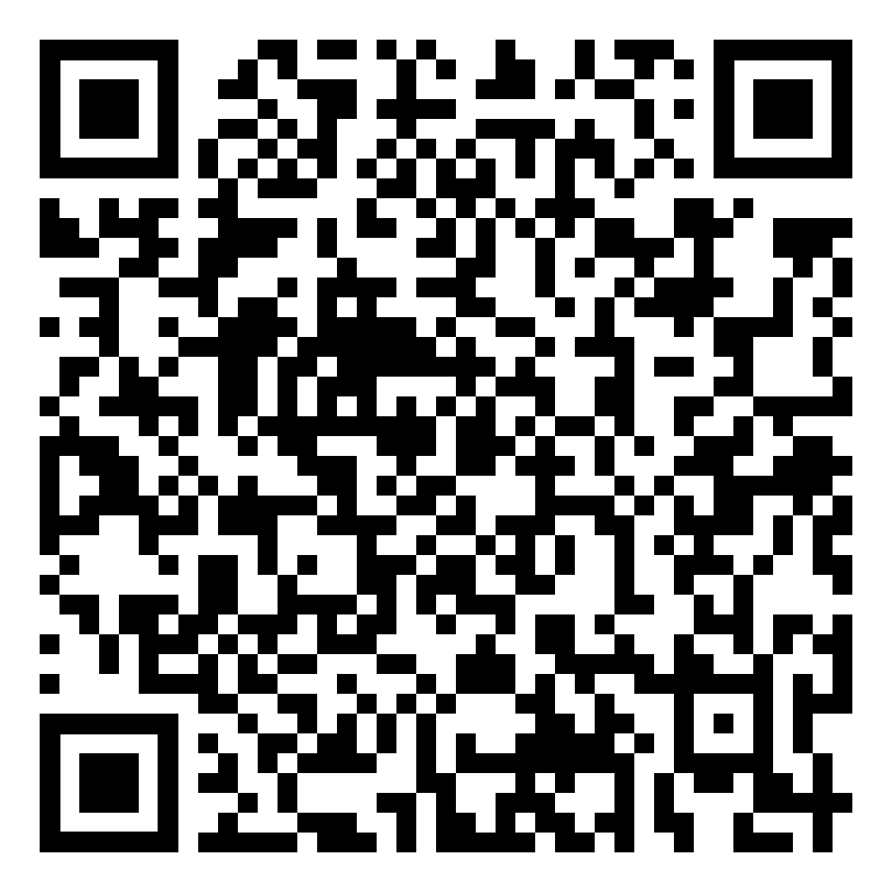
OH WAIT...PODCAST REAL QUICK

Slide 41
FREE STUFF!!!

Slide 42
FREE: DeliveredConference.com
FREE: GuruConference.com

Slide 43
“SEND ME EVERYTHING!”
SLIDES
NEWSLETTER
GURU CONFERENCE REG
BEST DAYS EMAIL CALENDAR…
‘SEND ME EVERYTHING’:
JayS@CorpWD.com

